Slide 1






A Novel Cybersecurity Architecture for IoV Communication
PCI 2021
25th Pan-Hellenic Conference on Informatics with International Participation 26 - 28 November 2021, Volos, Greece
Athanasios Sersemis, Alexandros Papadopoulos, Georgios Spanos, Antonios Lalas, Konstantinos Votis, and Dimitrios Tzovaras
Horizon 2020
European Union Funding
For Research & Innovation
This work is funded by the European Union’s Horizon 2020 Research and Innovation Program through SHOW project (https://show-project.eu/) under Grant Agreement No. 875530

Slide 2
Presentation Outline
Introduction
SHOW architecture for data transfer
SHOW cybersecurity mechanisms
Experimentation
Conclusions and future work
PCI 2021
27/11/2021

Slide 3
Motivation - Objectives
Motivation
Modern cars include more than 70 Engine Control Units and around 60 to 100 sensors.
Autonomous Vehicles (AVs) constitute the future of urban transport.
In the cybersecurity research field, a system in order to be secure should fill the CIA triad requirements for Cyber Security. C for confidentiality, I for Integrity and A for Availability.
A self-driving car communicates with external devices in a wirelessly way using the Internet. This communication is vulnerable by its nature and can be exploited if the system is not well configured.
Several attacks can be performed by malicious users to manipulate the connection.
Objectives
To define a secure architecture for data transfer from AV to cloud within public transport infrastructure.
To meet the CIA demands, i.e. to define a secure framework and the appropriate mechanisms that can guarantee the safety of all involved entities.
PCI 2021
27/11/2021

Slide 4
SHOW SOLUTION
SHOW architecture for data transfer
PCI 2021
27/11/2021

Slide 5
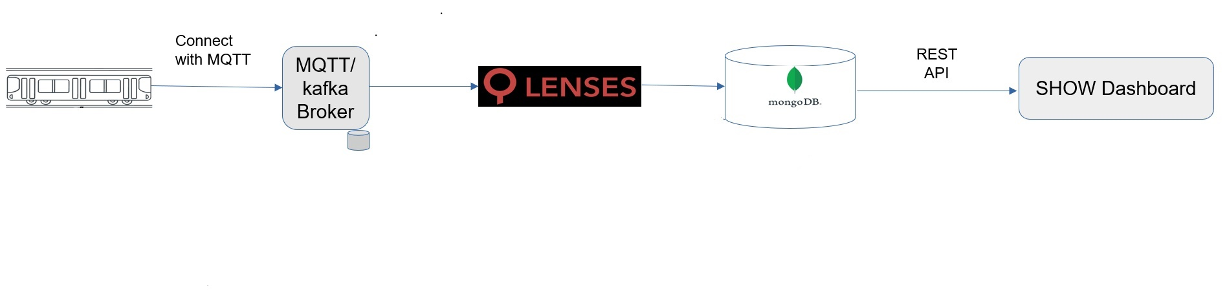





SHOW SOLUTION
SHOW architecture for data transfer
MQTT
LENSES.io
Apache KAFKA
MongoDB
Flask
SHOW cyber security mechanisms
KEYCLOAK
CLOUDFLARE
SNORT
NGINX
HASHING for integrity
PCI 2021
27/11/2021

Slide 6

SHOW architecture for data transfer
1. MQTT
MQTT stands for Message Queuing Telemetry Transport
Open-Source
Lightweight
Designed to perform on low-end and battery-operated devices such as sensors
Can deliver the data of over bandwidth constraint networks
MOSQUITTO framework
MQTTS with SSL/TLS certificates
PCI 2021
27/11/2021

Slide 7

SHOW architecture for data transfer
2. LENSES.io
Middleware for data visualization
Supports and maintains the open-source collection of KAFKA connectors
Enables data transfer from the KAFKA broker to other system components
Built with JAVA
Allows software operators to use SQL queries to search a group of desired data
Includes a MongoDB connector
PCI 2021
27/11/2021

Slide 8
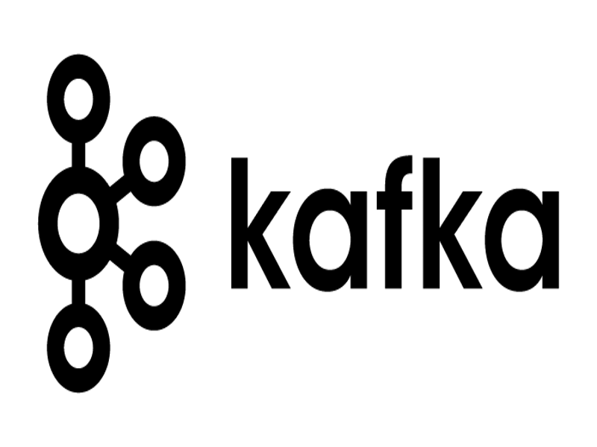
SHOW architecture for data transfer
3. Apache KAFKA
Popular and trustworthy platform
Enables the management of streaming data
Can receive and send data to third parties requests
Provides a single, low-latency, high-throughput network
Groups messages together in order to reduce the overhead of the network payload
PCI 2021
27/11/2021

Slide 9

SHOW architecture for data transfer
4. MongoDB
Open-source
Able to handle huge volumes of data
Able to handle different and unknown types of data
Supports JSON
PCI 2021
27/11/2021
Notes:
Ανάμεσα στο handle έχει δύο κενά

Slide 10

SHOW architecture for data transfer
5. Flask
Open-source
Web application framework to develop the server hosting the APIs where the data are accessible
Tools and libraries which can be used to connect FLASK with other system components.
PCI 2021
27/11/2021

Slide 11
SHOW SOLUTION
SHOW cyber security mechanisms
PCI 2021
27/11/2021

Slide 12

SHOW cyber security mechanisms
1. KEYCLOAK
Open-source
Identity and Access Management portal (IDM)
Oauth2
SSO
Social Login
Two factor authentication
Login and registration utilities
Token generation and authorization
PCI 2021
27/11/2021

Slide 13
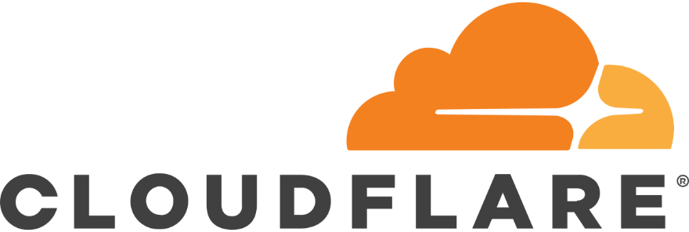
SHOW cyber security mechanisms
2. CLOUDFLARE
Free
Content Delivery Network (CDN) type product
Offers security against cyberattacks (DoS, SQL injection, identity theft)
Boost site performance and speed in loading
Visualizes network data critical for the infrastructure
Integrates a Web Application Firewall (WAF)
Can manage the SSL/TLS connections
Acts as a large VPN that hides the real server IP address
PCI 2021
27/11/2021

Slide 14
SHOW cyber security mechanisms
3. SNORT
Open-source
Signature-based Intrusion detection system
Captures network traffic packets
Recognizes known patterns
Processes packets on standard Ethernet-based networks with high velocity per packet.
PCI 2021
27/11/2021

Slide 15
SHOW cyber security mechanisms
4. NGNIX
Open-source
High performance http and proxy server
Redirects all the traffic from the localhost original ports to specific secure ports
Includes load balancers
Use of SSL/TLS protocol to secure system ports accessible over the internet
PCI 2021
27/11/2021

Slide 16
SHOW cyber security mechanisms
5. HASHING for integrity
Ensures data integrity
SHA-256 algorithm
Hashes comparison (the hash of the sent message and the hash of the received message) to check system’s integrity
PCI 2021
27/11/2021

Slide 17
EXPERIMENTATION
PCI 2021
27/11/2021

Slide 18
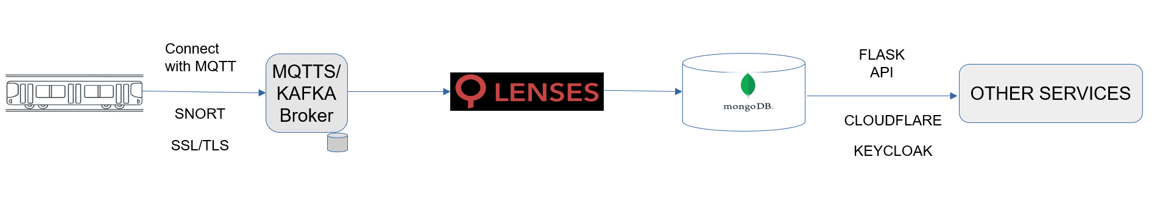
Connection results – Component Connection
System Pipeline
MQTT broker that receives the data from the vehicle
MQTT messages are guided to the KAFKA broker through LENSES.io connector (MQTT-KAFKA connector)
The data is stored to MongoDB (KAFKA-MongoDB connector)
JSON data format for the pipeline
The stored data can be utilized and exposed to the internet with the FLASK library
CLOUDFLARE proxies the traffic to its own infrastructure and offers security service
KEYCLOAK enables restricted access and role access to the exposed endpoints
PCI 2021
27/11/2021

Slide 19
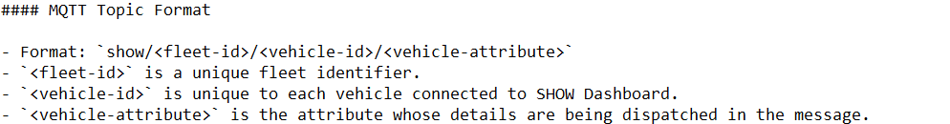
Connection results – Component Connection
MQTT Topic Name Structure
A common language has to be defined
Boosts the interoperability between different components
Forces a strict schema limiting the communication and the processing time of IDS to identify threats
PCI 2021
27/11/2021

Slide 20
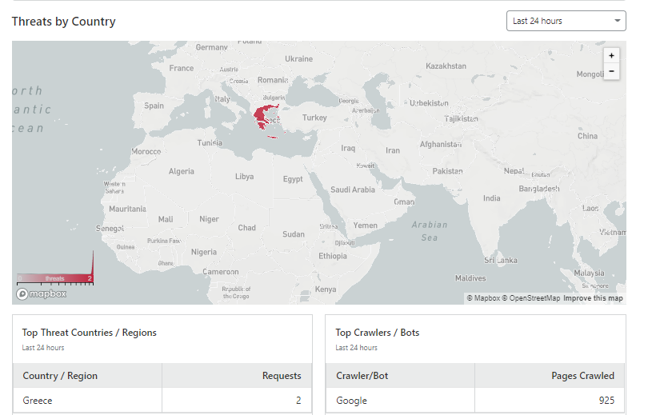
Security Results
Denial of Service (DOS)
Distributed DOS (DDOS)
DOS and DDOS attacks were performed to test the availability of SHOW system CLOUDFLARE managed to discover the attacks.
Under attack mode
JavaScript challenge (CAPTCHA )
Detailed Analytics
Cyber Security tools
SSL/TLS certificates
Edge to edge strict encryption
PCI 2021
27/11/2021
Notes:
Cyber Security Engineers can then activate the under-attack mode inside CLOUDFLARE management console. In
under-attack mode, CLOUDFLARE obligates the user or the hacker to pass a JavaScript challenge. In case the user is a
legit one, they can access the site after a successful submission. On the other hand, when a non-human user tries to
access the site like a bot, or a web crawler then the access is prevented since a machine cannot pass the JavaScript test
generated from CLOUDFLARE. Thus, DOS attacks cannot reach the site with the JavaScript challenge in place and the
functionality of the website stays unchangeable. It is worth mentioning the fact that a slight increase was observable
in packet distribution time by pinging the site and watch the response times. When performed a DDOS attack an
increment from 10ms to 150ms is observed in time responses which lasted for 2 to 5 seconds approximately. This is
mainly because after a short time the CLOUDFLARE IDS recognized the unwanted connections and prevented them.

Slide 21
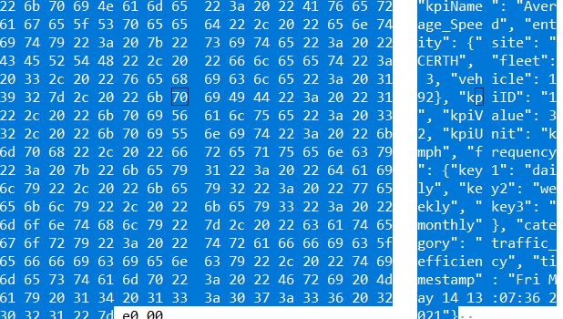
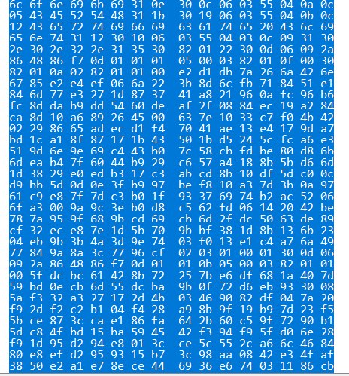
Security Results
Man in the middle attack (MITM) attack or spoofing
A malicious user that gained access to the network is shown and could sniff the payload of the message in transit
Non encrypted message
Encrypted message
PCI 2021
27/11/2021
Notes:
The malicious user owns the data and can use it to gain more privileged access to the system or to leak the data on the internet. This is problematic not only for the data itself since it may include confidential information but also for the schema that is used to send the data. A visible schema can be manipulated and changed.
A well configured MQTT broker will use SSL/TLS to encrypt the transferred data. In Fig5, it is displayed that the malicious user acting as a man in the middle can only see an encrypted message. SSL/TLS use x.509 certificates, asymmetric encryption and both public and private keys to hide the information included in the message payload. Finally, in order to avoid impersonation attacks, strong authentication should be placed in every component of the system. Every gateway, from the system should be recognized and forced to be accessed only by appropriate users. The Manuscript submitted to ACM et al. gateways in the proposed solution are the following: the MQTT gateway and the API gateway. The other components are used only for internal use and they are protected with firewall to prevent the internet access to these components and block specific ports. The MQTT gateway is protected with SSL/TLS certificates and traditional user authentication mechanisms with username and password. The Flask API gateway is protected with the KEYCLOAK server and the OAuth2/OIDC mechanism for authentication and identification.

Slide 22
CONCLUSIONS AND FUTURE WORK
PCI 2021
27/11/2021

Slide 23
CONCLUSIONS AND FUTURE WORK
Conclusion
Future work
The suggested architecture is
Safe
Robust
Open Source
Easy to implement
Satisfies the CIA triangle of cyber security
As a future work
Intrusion Detection System (IDS)
Secure Controller Area Network (CAN)
Secure Light Detection and Ranging (LIDAR)
PCI 2021
27/11/2021

Slide 24


Thank you!
Contact Details: Antonios Lalas
lalas@iti.gr
Centre of Research & Technology - Hellas
Information Technologies Institute
Horizon 2020
European Union Funding
For Research & Innovation
This work is funded by the European Union’s Horizon 2020 Research and Innovation Program through SHOW project (https://show-project.eu/) under Grant Agreement No. 875530

